Slide 1
Vibrant Community Initiative
Webinar Instructions:
Keep phone muted [*6] during the webinar
Use the chat feature to ask questions. The questions will be compiled after the webinar, answered, then distributed by email to participants, along with a copy of the presentation.
Virginia Department of Housing and Community Development

Slide 2
Agenda
How to Apply: Vibrant Community Initiative
Centralized Application & Management System (CAMS)

Slide 3
VCI Funding
Source | Amount
CDBG | $2 Million
HOME | $2 Million
Housing Trust Fund | $1 Million
VHDA | $500,000
TOTAL | $5.5 Million
Two projects possible
$2.75 million -maximum request –Non CDBG entitlement
$1.5 million -maximum request –CDBG entitlement
Must leverage other federal, state, and local resources
25 percent local match requirement (based on requested amount)
CDBG, HOME, HTF, VHDA, and other potential funding
Notes:
Talking point –depending on the number and type of projects… final funding amounts could be higher than $1.25 in CDBG entitlement areas.

Slide 4
Vibrant Community Initiative (VCI)
Combines multiple DHCD funding sources and VHDA resources
To fund transformative local/regional projects
To create larger local/regional impact

Slide 5
What is a transformational project?
A large multiple-faceted project
Focus on economic impact
Must leverage an existing community-driven planning process
Project readiness is key
Opportunity for planning and technical assistance for good VCI concept project to prepare for future VCI rounds
Notes:
Stress “project readiness” that we recognize that these types of projects take a lot to get started. VCI has built in a TA component to help those applicants that may need more assistance prior to the next round.

Slide 6
What is a transformational project?
Must include more than one component
A component is a smaller project that is under common contract/ownership/financing (e.g., multiple family rental project)
Must include a housing component
Any VCI-assisted housing component must include at least some affordable housing (50 – 80 percent or below AMI)

Slide 7
What kind of projects are we looking for?
Project can be located anywhere within the state of Virginia
Ideally we would like both urban and rural projects
Project should contain a range of activities such as neighborhood revitalization, downtown redevelopment, economic development, homeowner rehabilitation, down payment assistance, rental project development, water/sewer, and/or other infrastructure.

Slide 8
Project Caps
Project Location | VCI Project Cap*
CDBG Non-entitlement Localities | $2,750,000
CDBG Entitlement Localities | $1,500,000
Notes:
Note the possibility of higher funding levels (CDBG entitlement) based on number and type of project.

Slide 9
How can VCI be used in a project?
VCI supports one or more of the smaller project components
VCI funding for community development activities (non-housing) is limited to CDBG :
  VCI CDBG limited to CDBG non-entitlement communities
  CDBG entitlement must use other resource (e.g., local CDBG) to fund these components

Slide 10
How can VCI be used in a project?
VCI housing assistance must be structured as a loan –This is not a grant.
VCI assistance will support specific components of transformational project
  Contracts and negotiation will be specific to these smaller components
  Contracts will be structured to meet applicable federal and/or state requirements

Slide 11
Vibrant Community Initiative (VCI):Richmond Church Hill North/ East End Revitalization
Richmond City
$2.5 award ($22,324,030 total costs)
Mixed-income, mixed-tenure, multi-phased
Leveraging site of Armstrong High School
Build-first approach to replacing older public housing
Includes mixed-income family, senior rental, homebuyer
Larger project includes gateway and economic corridor improvements
Substantial local effort
Diversity of funding

Slide 12
Richmond Church Hill North/ East End Revitalization: VCI Funding
Richmond City is a CDBG entitlement locality
  Can’t use VCI CDBG funding
  These components funded with other resources
Senior 1B –multi-family affordable rental
  VHDA
  DHCD HOME
  Plus other non-VCI resources
Homeownership –mixed-income new construction
  DHCD HOME
  Plus other non-VCI resources

Slide 13
Vibrant Community Initiative (VCI):
Old Price’s Fork Comprehensive Revitalization Project
Montgomery County (Blacksburg area)
$2.5 award ($7,800,000 total costs)
Adaptive re-use of old school property
Existing structure to include senior rental housing, community kitchen, farm-to-table restaurant, business incubator, and market)
New construction mixed-income rental on property
Substantial local collaboration
Diversity of funding

Slide 14
Old Price’s Fork: VCI Funding
Multiple Family Mixed Income Rental
  VCI VA THF
  Plus other non-VCI resources
Brewery/market/restaurant
  VCI CDBG
  Locality is the grantee
  Local loan to the developer
Small Business Incubator
  VCI CDBG
  DHCD BEE
Notes:
Already had a prior commitment in senior rental component.

Slide 15
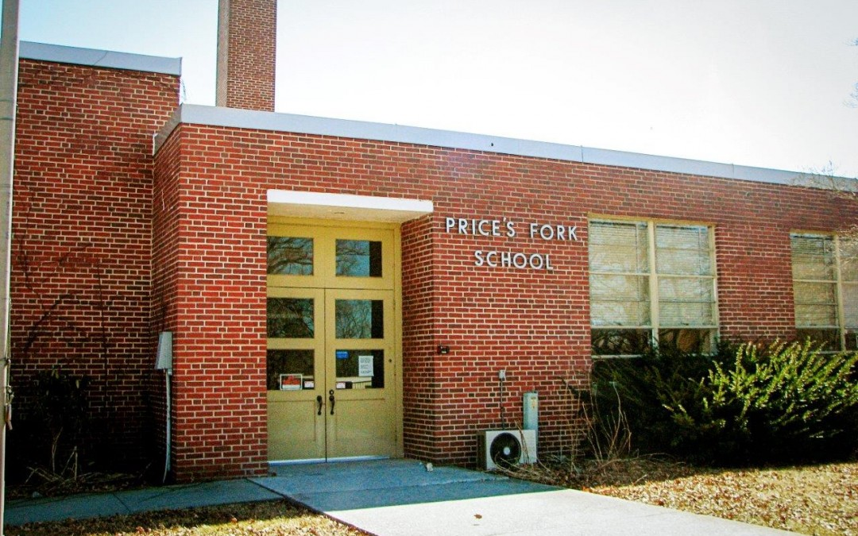
Old Price’s Fork

Slide 16
Vibrant Community Initiative (VCI)
Open process with pre-application accepted by August 23, 2019 deadline
DHCD will review pre-applications
Best, most promising (meeting pre-application scoring criteria) of pre-applications will be invited to submit full applications
Tentative full application deadline in January 2020

Slide 17
VCI Process
Decline
Site Visit
Decline
Planning Assistance
Full Application May 2018
Pre-Application (future round)
Decline
VCI Funded Project
Pre-Applications (current round)
Notes:
Highlight the planning assistance.

Slide 18
VCI Leverage
Pre-application reviews will favor projects that leverage other federal, state, and local resources
Leverage may include resources used for planning, coordination, and implementation
Leverage should be reflected in the application “other funding”
Notes:
Explain that “other funding” is a column in the pre-application budget (to be discuss further in the CAMS section of this presentation)

Slide 19
VCI Match Requirement
Projects must include a 25 percent match in locally controlled resources
Match amount = 25 percent of VCI request
May include locally controlled CDBG, HOME, fee waivers, local government resources, donated real property and/or other local funding (e.g. foundation)
Will consider the value of a loan requiring repayment

Slide 20
Pre-Application: Eligible Applicant
Entitlement or non-entitlement localities
Housing developers (nonprofit and for-profit)
Housing authorities
Local and regional housing, community, and/or economic development organizations
Good local process and partnerships are key
Looking for comprehensive community projects

Slide 21
Pre-Application: Eligible Applicant
Projects in CDBG entitlements must include the localities in early planning
Pre-application for projects in CDBG entitlement may be submitted by the project lead (non-profit, developer, locality, etc.)
Full applications in CDBG entitlements will be submitted by the locality

Slide 22
VCI Eligible Activities
VCI funding may support the following eligible affordable housing activities:
Homebuyer Direct Assistance, down payment and closing cost assistance (targeting 80 percent or below AMI)
Homebuyer Rehabilitation (targeting 80 percent or below AMI)
Homebuyer New Construction (targeting 80 percent or below AMI)

Slide 23
VCI Eligible Activities
VCI funding may support the following eligible affordable housing activities:
Homeowner Rehabilitation (targeting 80 percent or below AMI)
Rental New construction (targeting 60 percent or below AMI)
Rental Rehabilitation (targeting 60 percent or below AMI)

Slide 24
VCI Eligible Activities
VCI funding may support the following eligible economic development activities targeting low/mod income:
Job Creation/Retention
Site Redevelopment
Business Readiness
Business District Revitalization

Slide 25
VCI Eligible Activities
VCI funding may support the following eligible community facilities/services activities targeting low/mod income:
Water/sewer
Health Clinics

Slide 26
VCI Pre-Application
Selection Criteria
A plan and initial groundwork is in place on a comprehensive project that includes at least a housing component
Evidence that the project has solid local regional support
Partnerships in place to execute project
Demonstrated success with similar project
Demonstrated capacity (financial and development team)

Slide 27
VCI Full Application
Selection Criteria
By invitation only
Criteria:
  Alignment
  Need
  Project Readiness
  Capacity

Slide 28
VCI Full Application
Alignment Criteria
Consolidated Plan
Order Number 25: Establishing the Governor’s Affordable Housing Priorities to Address Virginia’s Unmet Housing Needs
HOME Investment Partnership
Community Development Block Grant

Slide 29
VCI Full Application
Alignment Criteria
Preservation of existing affordable rental units
Preservation of existing affordable homebuyer units
Creation of new affordable rental units
Creation of new affordable homebuyer units
Creation of integrated community housing units targeting special needs population

Slide 30
VCI Full Application
Alignment Criteria
Fair housing and communities of opportunity
Employment/infrastructure/community services that primarily benefit very low/low/ and moderate income households
Blight removal as a part of a larger revitalization project

Slide 31
VCI Full Application
Need Criteria
The degree to which the project is designed to meet an identified local need
Must be demonstrated by a local market analysis or needs assessment
What is the need, how do you know, and what is the expected result?

Slide 32
VCI Full Application
Project Readiness Criteria
Review of project status, timeline (s), challenges and barriers
Assessment of costs and status of other funding commitments
Level of stakeholder involvement in needs assessment, planning, and design

Slide 33
VCI Full Application
Capacity Criteria
Applicant, partners, and development team
Existing development, project management, and financial capacity
Must describe existing resources for project planning, coordination, and implementation
Should identify project management gaps/needs

Slide 34
VCI Timeline (Tentative)
Application Stage | Target Date
Release of guidelines and pre-application materials | June 2019
How to Apply Workshops | June 26, 2019 (1 – 3:00 PM)
Pre-application due date | August 23, 2019
Full application due date | January 2020

Slide 35
VHDA Funding Sources
Homeownership
  Down payment assistance and lower interest rates
Rental
  Predevelopment
  Taxable and tax-exempt financing
  SPARC
  LIHTC
Mixed-use/Mixed-income
  Permanent loans
REACH Resources
  Grants supporting other affordable housing
Contact:
  Community Outreach:
  Chris Dimotsis
  chris.dimotsis@vhda.com 804-343-5596

Slide 36
CAMS Tips
All work in CAMS should be frequently saved
Please note that Chrome is the recommended browser
Work in Word and copy and paste into the CAMS text boxes
Use the “Print” tab at the top of the page and review them for completeness and accuracy
The text box will only accommodate text responses. Graphic, tables, charts should not be pasted into the narrative section; instead, include the information in a separate attachment

Slide 37
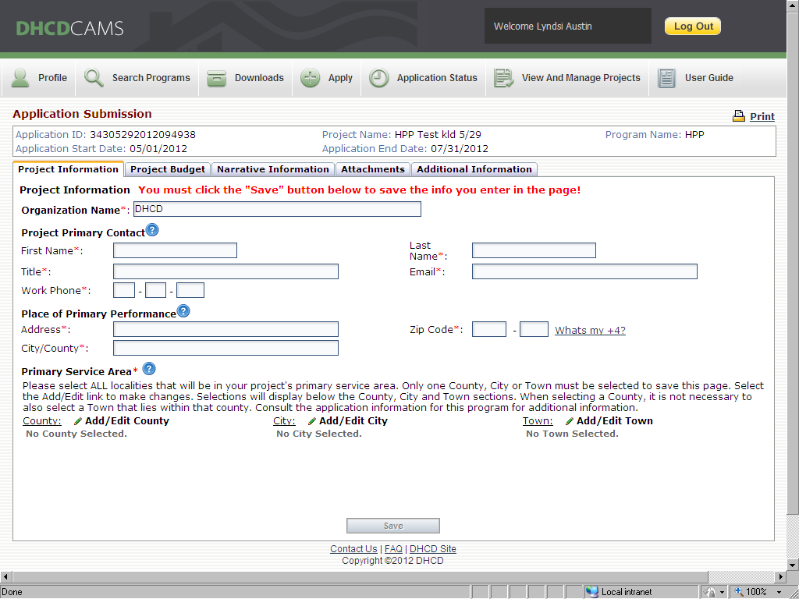
Project Information

Slide 38
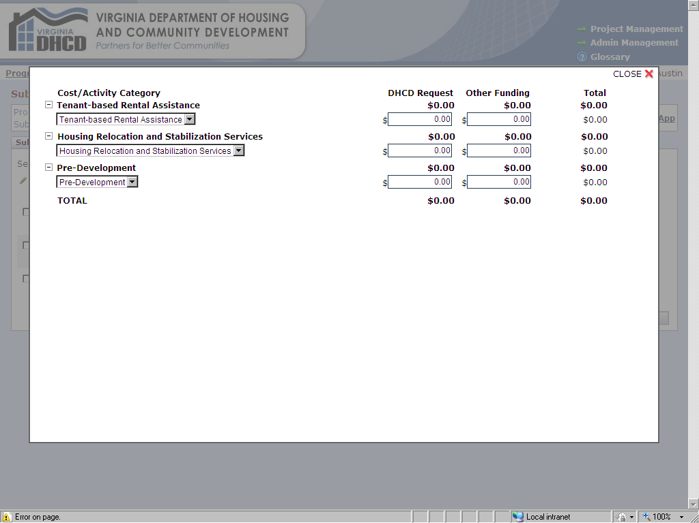
Project Budget

Slide 39
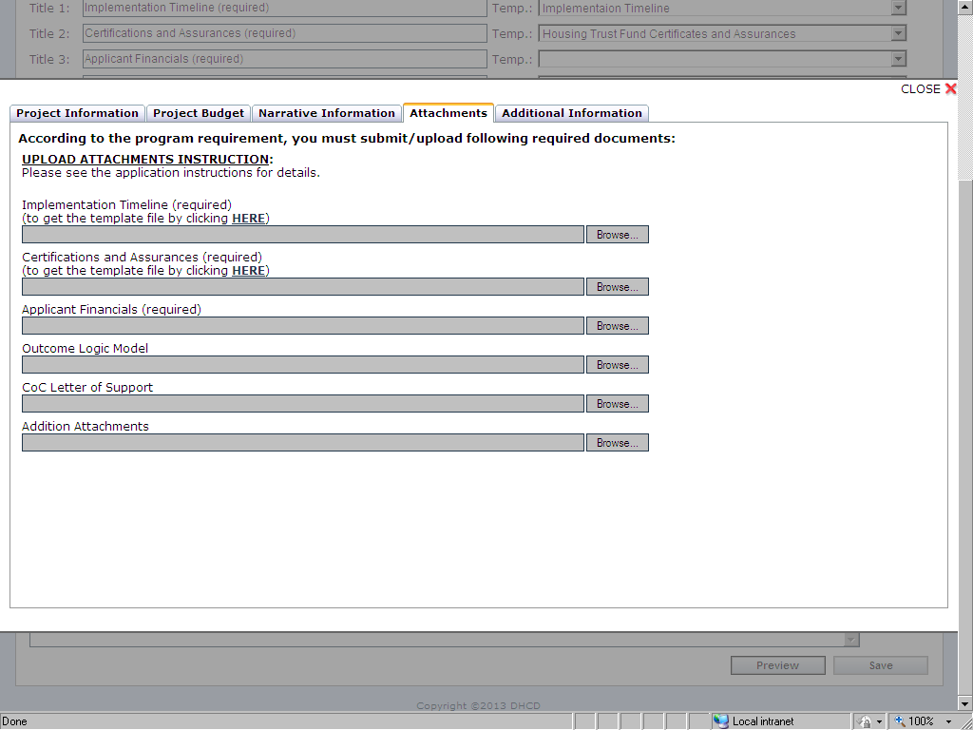
Attachments

Slide 40
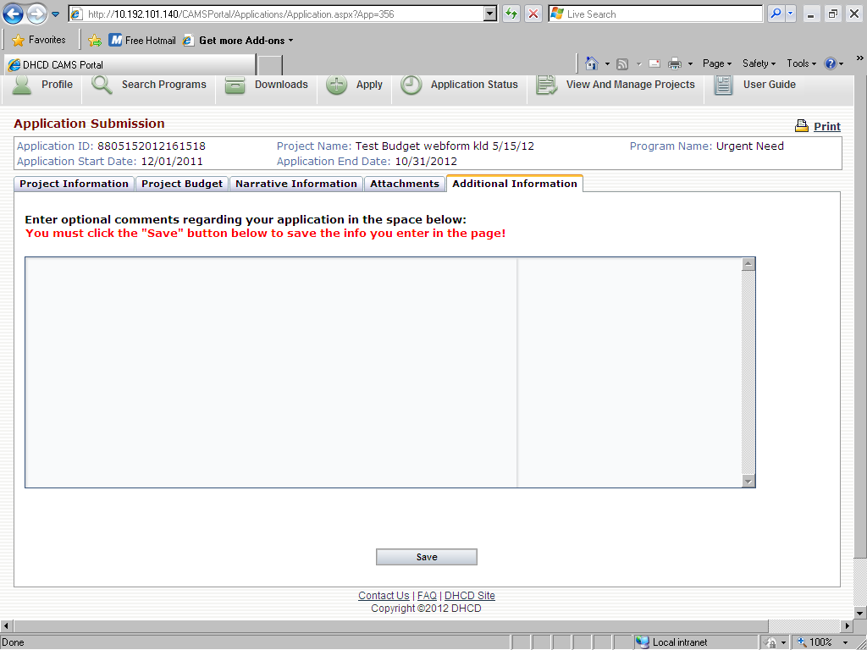
Additional Information

Slide 41
Application Status
Multiple users can work on, edit and review application materials.
CAMS will save the application as Incomplete. Applicant may return repeatedly to CAMS to work on application.
Please be sure all work on the application is saved in CAMS.
Once the application is submitted the status will change from Incomplete to Pending.

Slide 42
Vibrant Community Initiative (VCI)
DHCD Staff Contact:
Lyndsi Austin
lyndsi.austin@dhcd.virginia.gov
(804) 371 – 7122

